Slide 1

KIET GROUP OF INSTITUTIONS​

Slide 2
PROJECT BASED LEARNING
SUBJECT:Data Structure
TOPIC: Modern Periodic Table
​TEAM MEMBERS:
AMAN KHAN(2100290110018)

Slide 3
Mordern Periodic Table:
The modern or long form of the periodic table is based on the modern periodic law. The table is the arrangement of elements in increasing order of their atomic numbers. The modern periodic table is the present form of the periodic table. And it consists of 18 vertical columns and 7 horizontal rows.

Slide 4
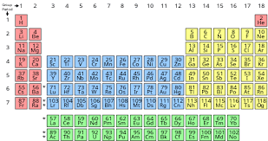
How modern periodic table look like

Slide 5
Functions used:
void add(): This function is used to input or add the information of new element to the program.
void explor(): This function is used to explore the stored information in the file created.
void mainscreen(): It is included in source code of project file in order to print the text style and to control its color.
void mainscreen(): This function is used to print the main screen or menu of the project.

Slide 6
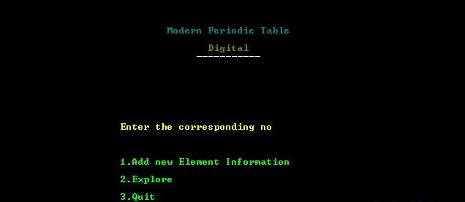
PRIMARY GOALS
Annual revenue growth

Slide 7
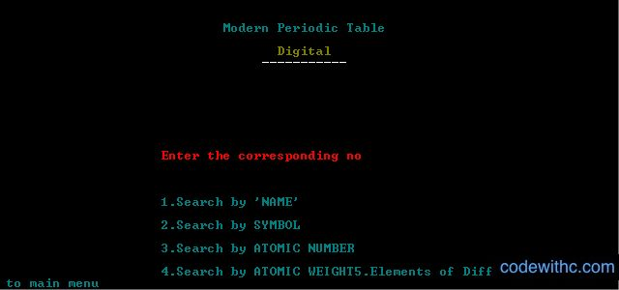
QUARTERLY PERFORMANCE

Slide 8
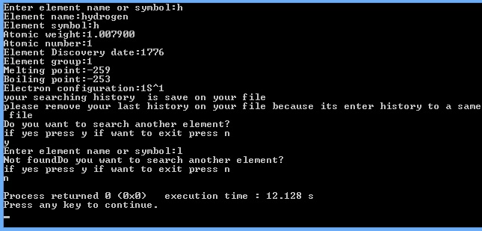
AREAS OF GROWTH
 | B2B | Supply chain | ROI | E-commerce
Q1 | 4.5 | 2.3 | 1.7 | 5.0
Q2 | 3.2 | 5.1 | 4.4 | 3.0
Q3 | 2.1 | 1.7 | 2.5 | 2.8
Q4 | 4.5 | 2.2 | 1.7 | 7.0

Slide 9
Reference: https://www.codewithc.com/modern-periodic-table-c-project/ https://www.w3schools.com/c/c_structs.php

Slide 10
Thank you☺

